Slide 1
Introduction to University Travel and Accounts Payable
June 2021

Slide 3
Accounts Payable Contacts
Name Phone Email Job Title
Vacant 349-2060 Accounts Payable Manager
Laura Signorile 349-6622 lsignoril@coastal.edu Travel Card Coordinator
Brenda Rabon 349-2044 brabon@coastal.edu Accounts Payable Technician
Tammy Parker 349-2185 tparker@coastal.edu Accounts Payable Technician

Slide 4
Where is Accounts Payable located?
290 Allied Dr.
Conway, SC 29526

Slide 5
Training Agenda
Accounts Payable
University Travel
Required Forms and Documents
Corporate Travel Card
Q&A

Slide 6
Payment Methods
Check
Checks are processed once a week, normally on Thursdays
Direct Deposit
Employee reimbursements will be direct deposited into the bank account on file for payroll direct deposit.
Non-employees will be paid with a check or through Paymode-X.
Students will be paid with a check unless they have set up direct deposit on WebAdvisor.
Wire
Vendors may be paid by wire transfer. Wire information must be provided to Accounts Payable when submitting the invoice for payment. The Office of Financial Services staff will verify the information before wiring funds.
Required Information:
Financial Institution Name
ABA Routing Number or SWIFT Code
Bank Account Number or IBAN
Payee’s Bank Account Name

Slide 7
What form do I need to pay an invoice?
Non-PO invoices should be paid on your p-card if it is an allowable p-card expense, and the vendor accepts credit card payments. If payment can not be made with p-card: No form is necessary. Budget officer writes account number to be charged on the invoice, signs, and forwards invoice to AP. (email to apinvoices@coastal.edu).
No form is necessary for PO Invoices. Send the invoice to apinvoices@coastal.edu and notify Central Receiving that merchandise or service has been received.
No form is necessary for BPO Invoices. Budget officer writes BPO number on the invoice, signs, and forwards invoice to apinvoices@coastal.edu.
Reminder: Purchases for goods and services must be on state contract. Information regarding state contracts and approved vendors may be accessed on the Procurement website: https://www.coastal.edu/procurement/facultystaff/statecontracts/

Slide 8
What form do I need to get reimbursed for Non-travel expenses?
Reimbursement for expenses that I paid with personal funds
Expense Settlement Form
Note: detailed (itemized) receipts must be submitted which shows proof of payment, and Food Expense Justification section must be completed if food was purchased.
Reimbursement for local mileage within a 50 mile radius
Local Mileage Reimbursement Log
Reimbursement for Relocation Expenses
Relocation Expense are no longer reimbursed through Accounts Payable.
Contact Belinda Pope in Human Resources.

Slide 9
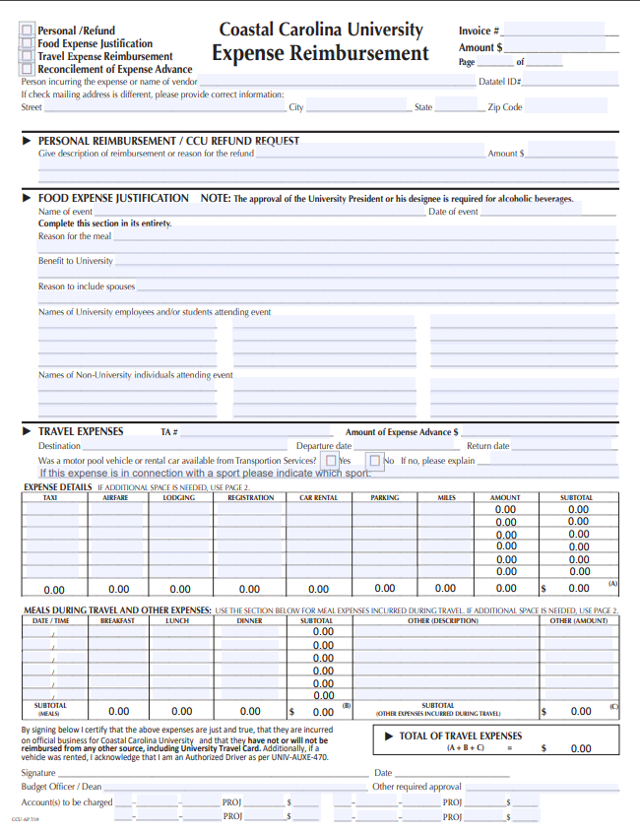
Coastal Carolina University
Expense Settlement Form
This form includes sections for Personal Reimbursement, Refund Request, Food Expense Justification, and Travel Reimbursement.
Explanation of each section:
The first section includes the payee name (including their Datatel ID number), the amount, and invoice number if applicable.
The second section is for personal reimbursements and refunds. It includes the description of the reimbursement or refund, and the amount.
The third section is the Food Expense Justification which is required when seeking reimbursement for food purchases.
The fourth section is Travel Expenses where all reimbursable travel–related expenditures are listed.

Slide 10
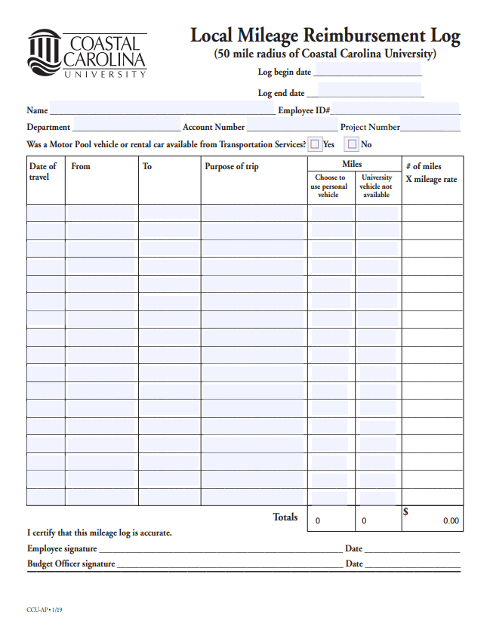
Local Mileage Reimbursement Log
This form is only used for mileage within a 50 mile radius of the University.
No map back up is required.
Employees should always check off “Yes” and use the column “Choose to use personal vehicle”. Motor pool vehicles are always available for employees.
Non-employees and students should check off “No” and use the “University vehicle not available” column.

Slide 11
What form do I need to pay an Honorarium?
Honorarium Form
An honorarium is generally a payment made as a “token of appreciation” to an individual where there was not a contractual payment agreement between the parties.
Refer to CCU policy FAST-203 for eligibility, exclusions, and processing.

Slide 12
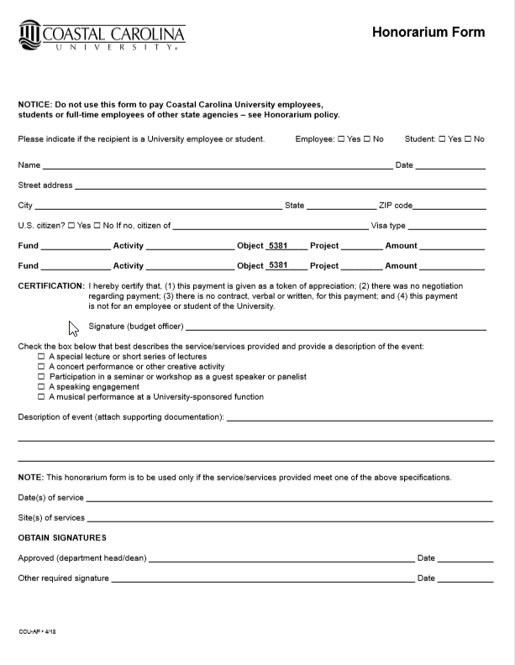
Honorarium Form - FAST-203
SUMMARY: This policy sets forth guidance to departments and governance of honorarium payments. These payments are typically paid to individuals of scholarly or professional expertise with the clear intent of showing goodwill and appreciation for a voluntarily service to the University.
POLICY:
I. An honorarium is a nominal payment made to an individual, not an employee or student of the University, for a special and non-recurring activity or event with a short duration for which a fee is not legally required. If the amount or timing of the payment is negotiated and agreed upon, it is considered a contractual agreement, and should be processed as a payment for personal services, not an honorarium. Risk Management requires a certificate of insurance (COI) for all services provided, unless waived by University Counsel. As a general rule, a COI will be waived if the service provider is not in business and does not normally receive fees for the service rendered.

Slide 13
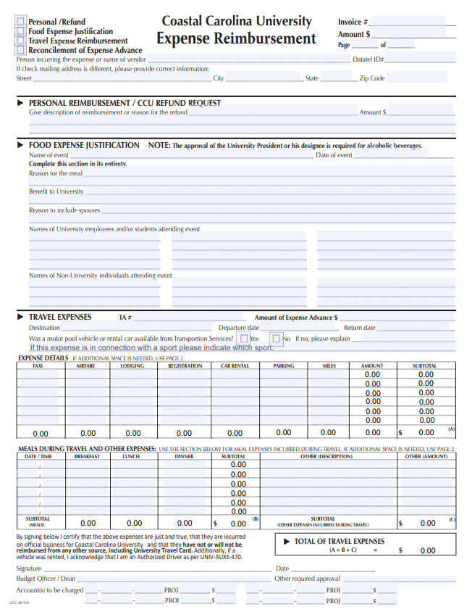
What form do I need for Refunds?
Expense Settlement Form – CCU Refund Request section
Use the same account number in which the money was deposited.
Copy of receipt or other documentation must be attached to request.

Slide 14
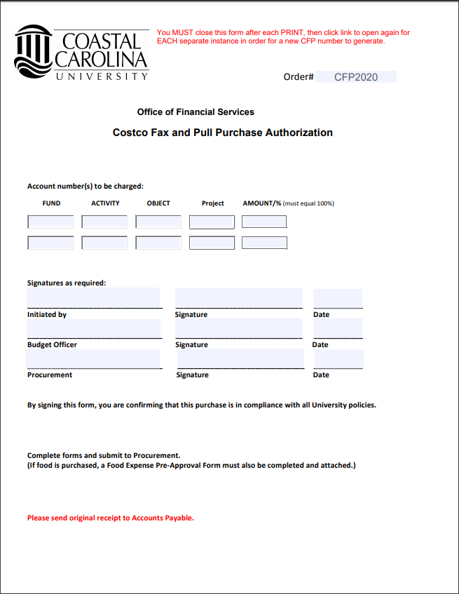
This form automatically assigns an Order #.
When completing this form assign the GL Account to be charged for the purchase. The Initiator will sign the form, forward it to the Budget Officer for approval, then fax to Procurement.
There is a minimum order of $200.00

Slide 15
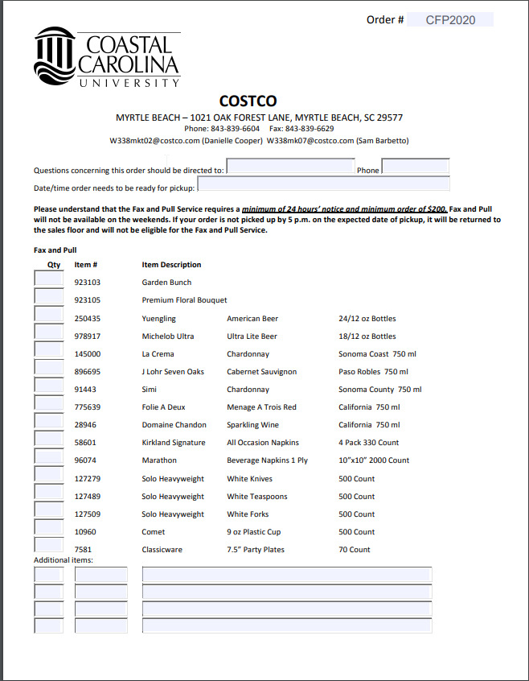
This is only a few items that they have listed available from Costco. If requested items are not listed you may call Costco to get the item # and then complete the Additional items section.
Make sure the top of the form is completed too.
**Remember - Alcohol requires approval of the President or his designee, and food requires the Food Expense Justification form.
Once items have been picked up from Costco, send the receipt with the fax and pull directly to ap@coastal.edu

Slide 16
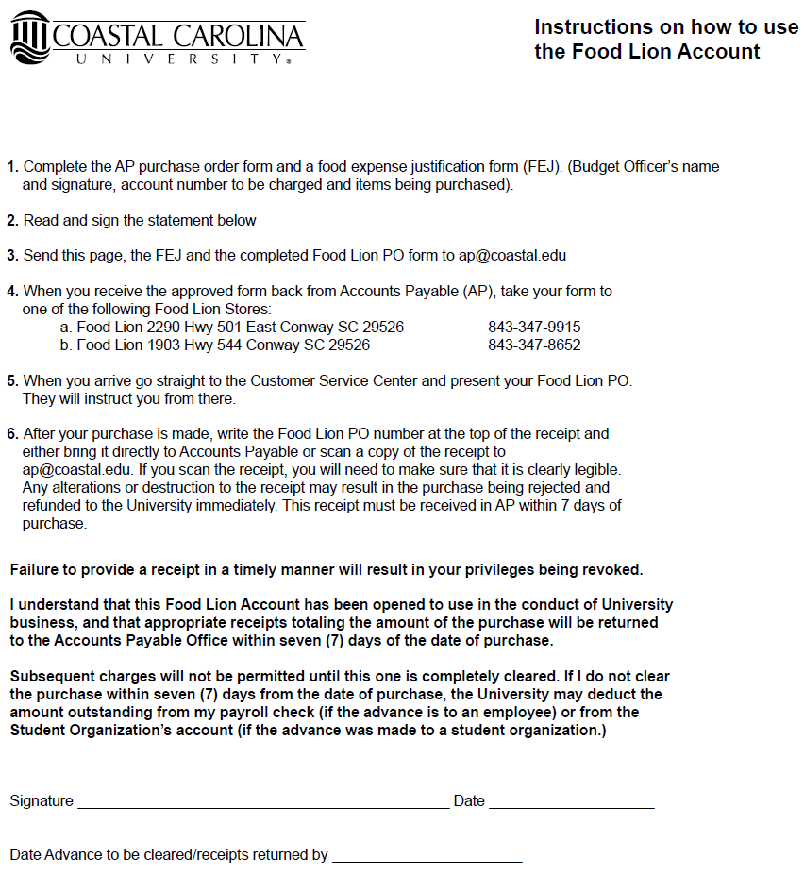
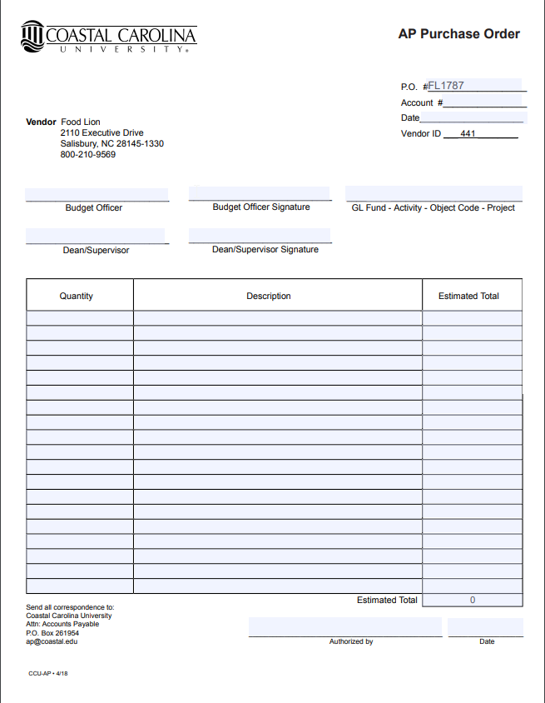
Food Lion Direct Billing

Slide 17
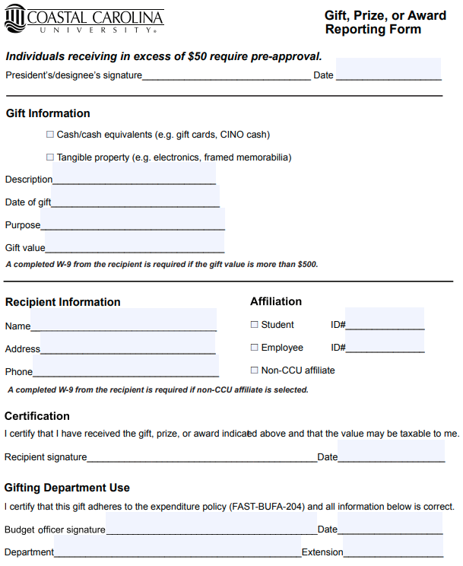
Gifts Reporting Form This form helps keep track of gifts being given out across campus purchased with University Funds. When giving a gift this form needs to be completed and returned to Accounts Payable. BEFORE any gifts are given, you MUST verify in University Policy first to see if it is allowable! If you have any questions, please ask before you give a gift or payment out.

Slide 18
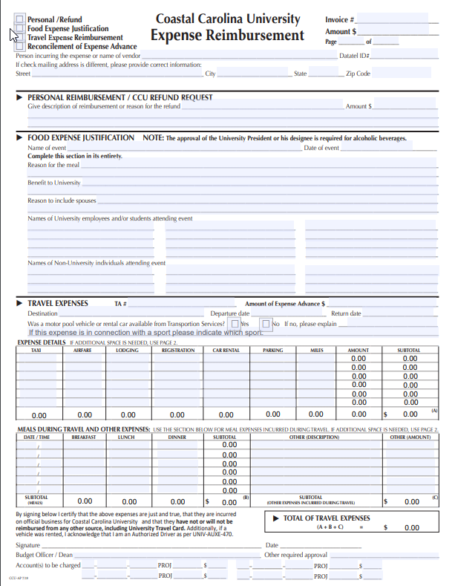
Reimbursement of Cell Phone Charges

Slide 19
University Travel
Travel – Authorizations & Reimbursement Policy (excerpts) – FAST-201
Summary: The regulations in this statement govern travel at University expense. Employees will be reimbursed for travel expenditures in compliance with University guidelines as governed by state and federal travel regulations. Adequate documentation must exist to allow for verification of expenditures. Employees should exercise discretion in incurring any and all expenses. Neither personal expenses nor excessive costs and unnecessary or unjustified expenses will be reimbursed. University employees should be as conservative as good taste and circumstances permit in the expenditure of funds for official travel.
Use of proper forms: Upon the traveler’s return, claims for reimbursement of travel expenses should be completed, approved and submitted on the E x p e n s e S e t t l e m e n t F o r m as soon as possible but not to exceed 30 days after the trip ended to receive reimbursement for qualified expenses. A separate Expense Settlement Form must be filed for each authorized traveler. Information on all forms must be legible and completed in its entirety. Before reimbursements will be made, all Travel Authorizations submitted for employees require the signature of the individual authorized to sign for the account being charged.
Proper approval: Individuals traveling on University business should do so only with approval of appropriate officials on a Coastal Carolina University Travel Authorization (TA) Form, which is available on the Forms webpage or Accounts Payable webpage. Appropriate officials is defined as the Budget Officer; however, if the Budget Officer is the traveler, their supervisor must approve the Travel Authorization Form.

Slide 20
What form do I need for Travel?
Planning to travel
Travel Authorization (TA) form
Cash advance to pay for travel expenses
Expense Advance Request form
Reimbursement for my travel expenses
Expense Settlement form

Slide 21
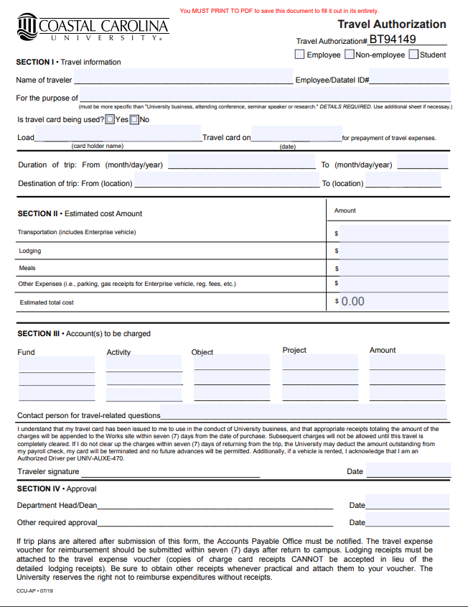
Travel Authorization Form
Travel expenditures and reimbursement
will comply with University Policy:
Travel – Authorizations and Reimbursement (FAST 201).
Travel authorization form is
Located on the forms page online:
https://www.coastal.edu/forms
Travel authorizations should be sent to aporders@coastal.edu.

Slide 22
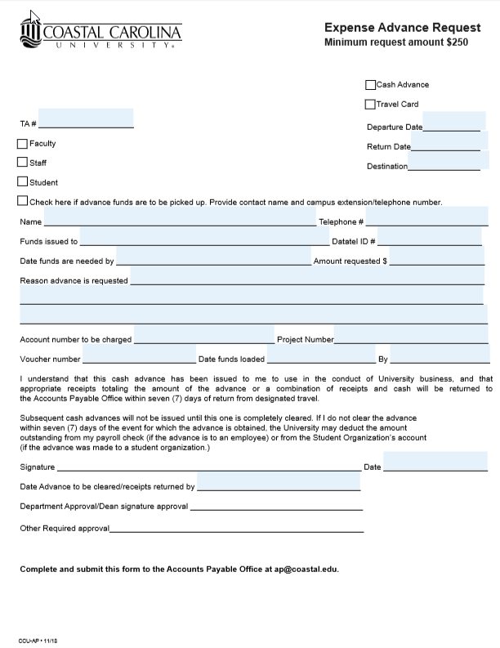
Coastal Carolina University
Expense Advance Request
Minimum request amount $250
This form is used for Cash Advances and Corporate Travel Card loads.
There are 3 sections of this form:
Top section tells us if there is a TA, the status of the person receiving the advance, when the person is leaving and returning and where their destination is, and if the advance needs to be picked up.
Middle section is who is receiving the money including their Datatel ID number, when the funds are needed by and the amount requesting with a description of why the advance is needed. Also will need to know the account number to be charged.
Last section is for the person receiving the advance to read and agree to by signing the form. Then the Budget Officer or Dean will sign.
Notes:
Please allow the Accounts Payable Staff enough time to process Advance Requests. This should not be an item that is sent the day before it is needed, the individual will not receive the money in time.

Slide 23
Pocket Guide to Travel (handout)

Slide 24
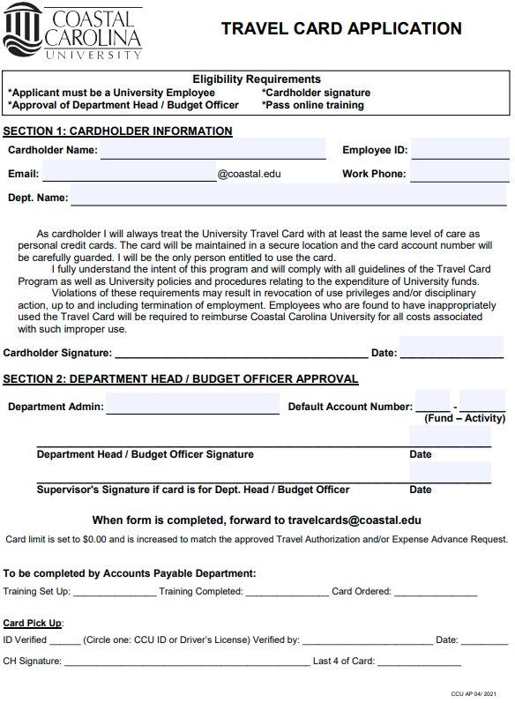
Corporate Travel Card
Any employee is eligible for a travel card, which is a MasterCard through Bank of America.
Travel Cards can be used for hotel, airfare, registration, car rental, shuttle, taxis, gas, and other travel-related expenses EXCEPT FOOD.
Training must be completed in Moodle and a test taken with a 85% passing grade to receive the travel card.
Transactions that do not have detailed receipts or are not an approved expense by policy guidelines must be reimbursed back to the University.
Cardholders are responsible for allocating the charge in Works, uploading receipts, and signing off on transactions.
All transactions must be signed-off on no later than 7 business days after the date of the transaction.
No funds are loaded on the card until the approved Travel Authorization has been sent to AP.

Slide 25
P-Card vs. Corporate Travel Card (handout)

Slide 26
Bank of America
Login to Works
You must select “Coastal Carolina Univ” as your Organization.
Same exact set-up as the P-Card; however, your Login Name and password are different than it is for the P-Card.

Slide 27
Bank of America
Action Items: A place to work outstanding transactions and see if there are any flagged transactions.
Accounts Dashboard: You need to check this area to see if money has been added to your card.

Slide 28
Bank of America
Pending Sign Off:
Uploaded Receipt must be Yes
Allocation should be GL/Fund/Obj 10 digits
Comp/Val/Auth should have all green check marks.
If your transaction is flagged it will show yes and who flagged it.

Slide 29
Bank of America
If you click on the TXN # the pop-up box will come up. From here you can Allocate your charge, add receipts, add the charge to expense reports for monitoring spend, and sign off on the transaction.

Slide 30
All invoices, reimbursements, refunds or any payments should be sent in to apinvoices@coastal.edu.
All Travel Authorizations should be sent to aporders@coastal.edu.
Each payment request should only be one PDF file per email.
If you have questions, send those to ap@coastal.edu, your request will go to all in AP and will be answered within a business day. For any travel card related questions, email travelcards@coastal.edu
If the invoice is received in your department, it is better to have the approval signed directly on the invoice and then forward to AP.
If you are sent an email directly from AP, please respond to that email and do not re-send anything through apinvoices@coastal.edu. We will let you know exactly what we need.
Direct link to Perceptive Software: https://img.coastal.edu:8443/experience/#login

Slide 31
Wrap Up
Questions?
Other suggested training classes??
Feel free to stop by to introduce yourself
and meet the Accounts Payable staff.

