Slide 1

Supervisor Training: Employee Performance Management System (EPMS)
Supervisor Training: Employee Performance Management System (EPMS)
August 2021

Slide 2
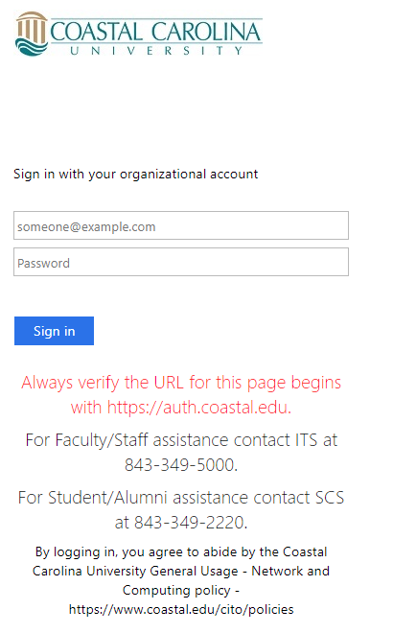
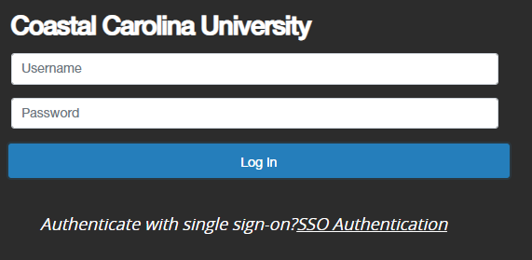
How to Access PeopleAdmin
Log into the PeopleAdmin system at: https://jobs.coastal.edu/hr
DO NOT add “www” before the address.
This is the same address as the “Applicant Tracking System.”
DO NOT use Internet Explorer – use Chrome or FireFox to open.
Select “SSO Authentication” to go to Coastal’s SSO site.
Enter your CCU credentials (example: Johnnyappleseed@coastal.edu then your CCU password).
Select “Sign in.”

Slide 3
Completing the EPMS Planning Stage
Completing the EPMS Planning Stage
Reminder: Please CONFIRM the accuracy of the position description. You will NOT be able to properly create the EPMS Plan if the position description is NOT accurate.

Slide 4
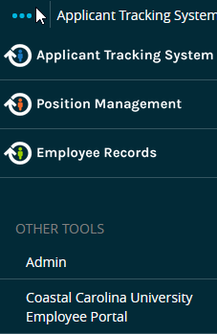
Completing the EPMS Planning Stage
A planning stage MUST be created prior to an evaluation being completed.
When completing the planning stage document, make sure your “User Group” – located near the top right - reflects “Supervisor.” If it does not, choose it from the drop down menu.
Select the three blue dots located near the top left (to the left of “Applicant Tracking System”) to reveal the “Coastal Carolina University Employee Portal” – choose that portal.

Slide 5
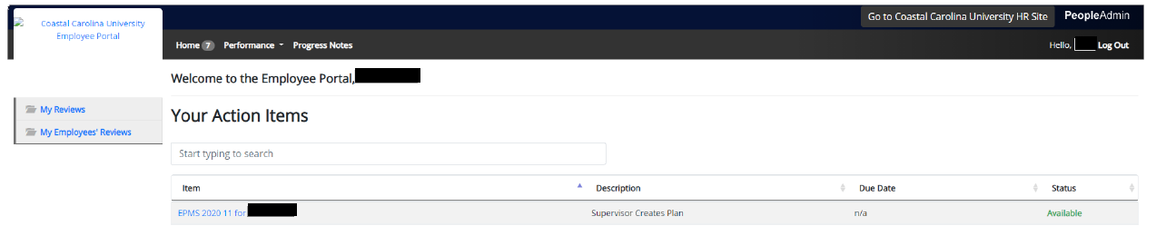
Completing the EPMS Planning Stage
The page will display “Your Action Items.”
Select an “Item” reflected in blue to begin the process of completing the planning stage.

Slide 6
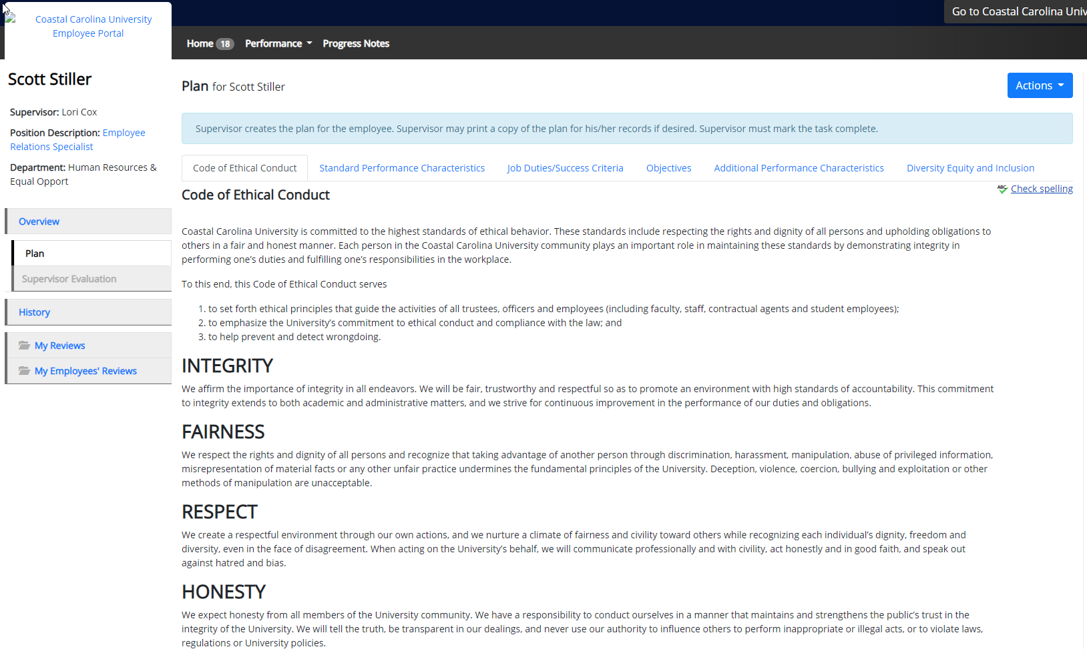
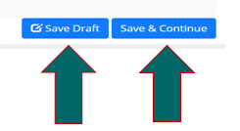
Completing the EPMS Planning Stage
Code of Ethical Conduct – No information needs to be added, simply select “Save & Continue.”

Slide 7
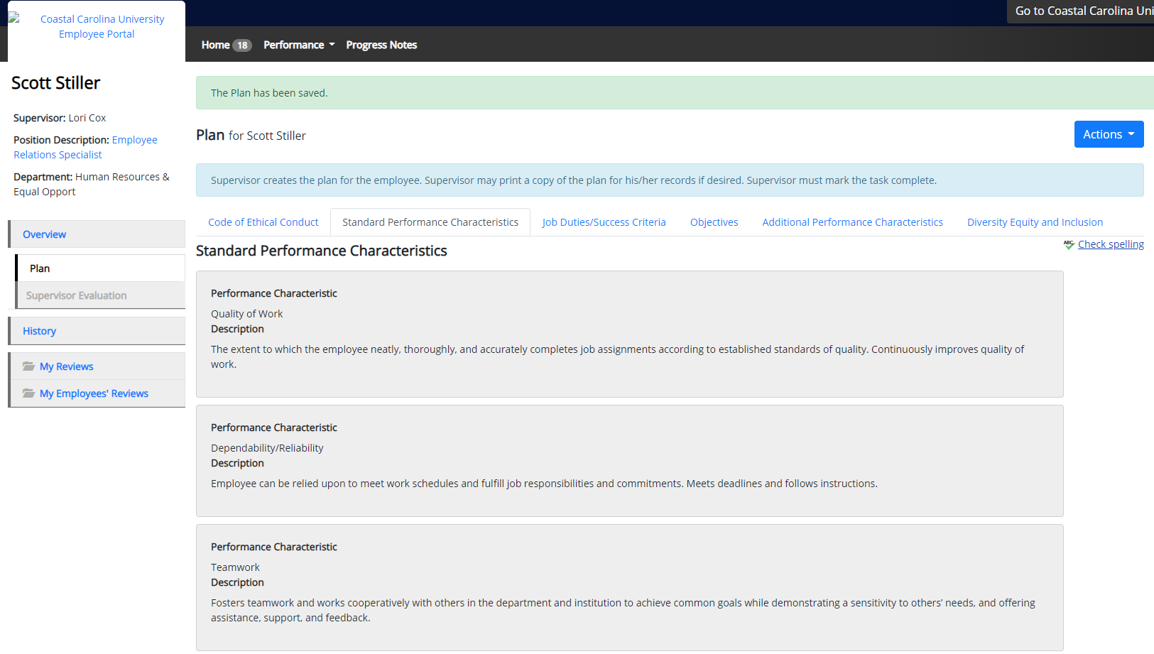
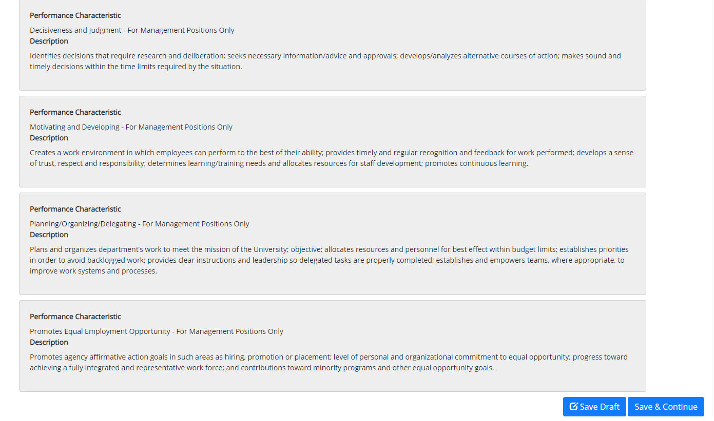
Completing the EPMS Planning Stage
Standard Performance Characteristics – No information needs to be added, simply select “Save & Continue.”

Slide 8
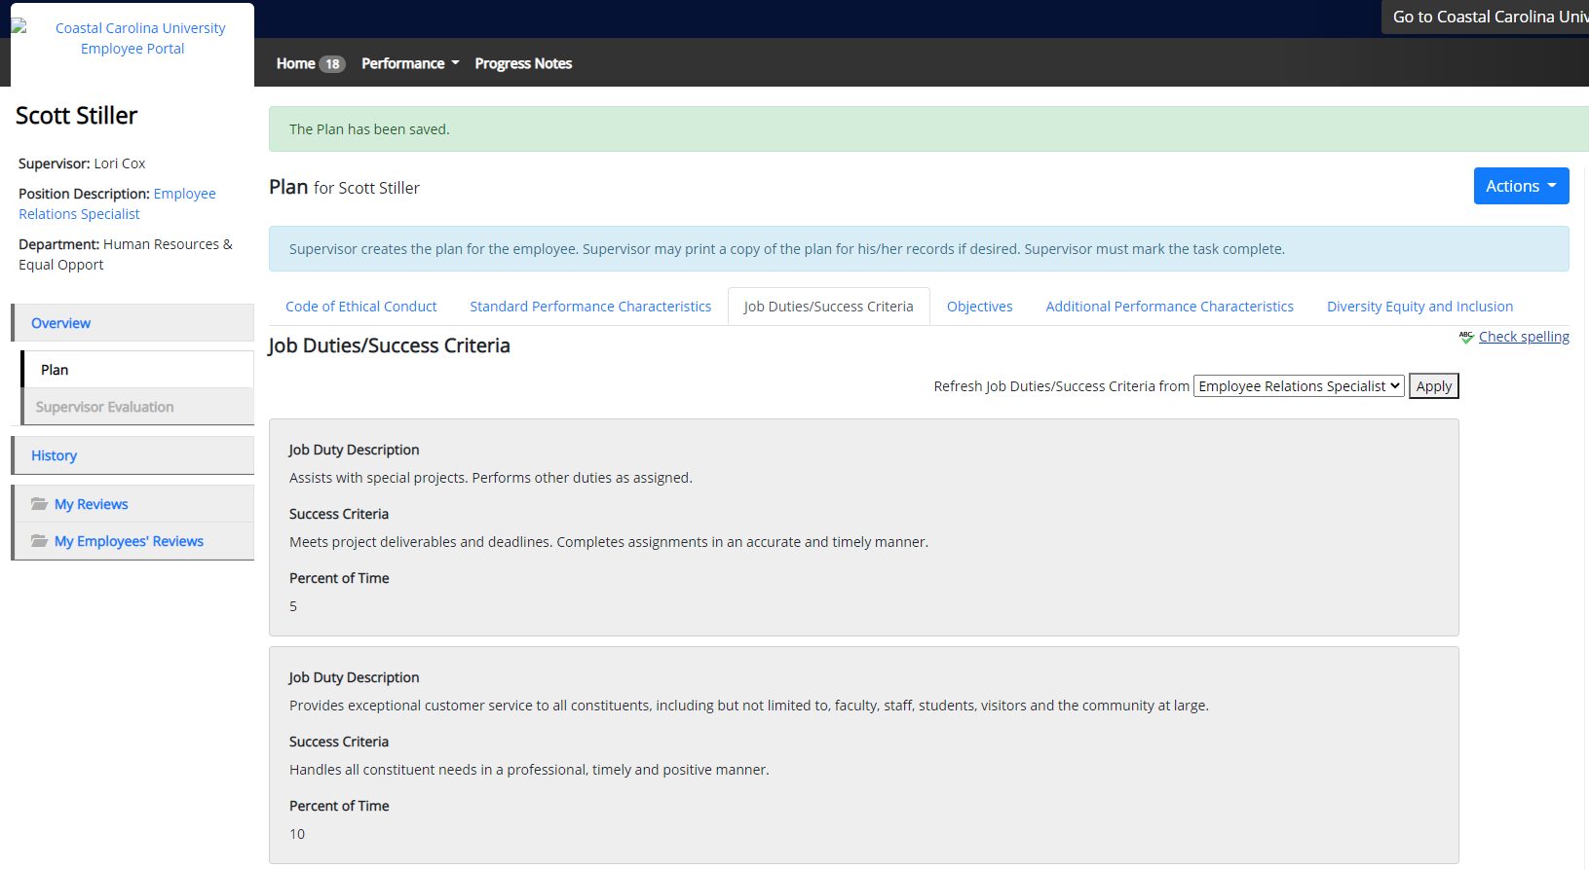

Completing the EPMS Planning Stage
Job Duties/Success Criteria should be reviewed.
If information is correct, select “Save & Continue.”
If information is incorrect, either STOP and contact HREO or choose the correct position from the “Refresh Job Duties/Success Criteria” drop-down and select “Apply.”
Select “Save & Continue.”

Slide 9
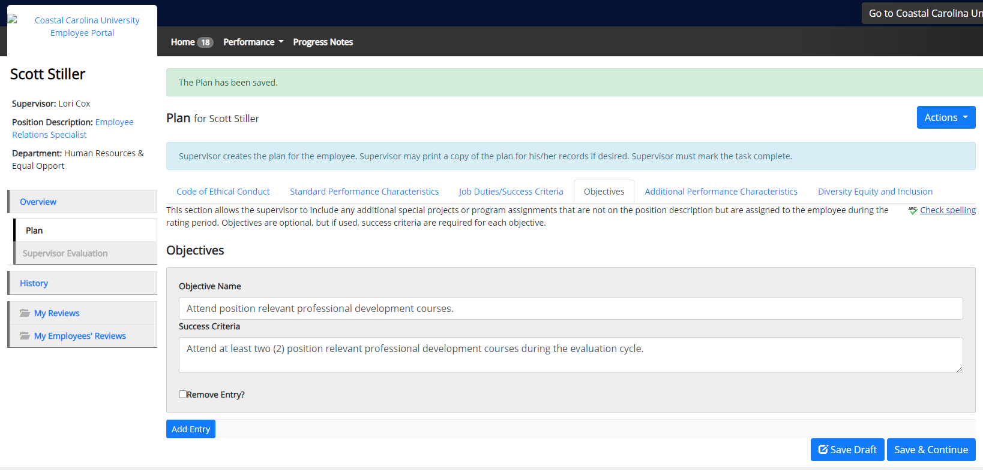
Completing the EPMS Planning Stage
Objectives should be included when an employee is assigned a special, non-recurring project or assignment that is not included on the employee’s position description and that is expected to be accomplished during the rating period.
These are optional – enter information and select “Add Entry”
Select “Save & Continue”

Slide 10
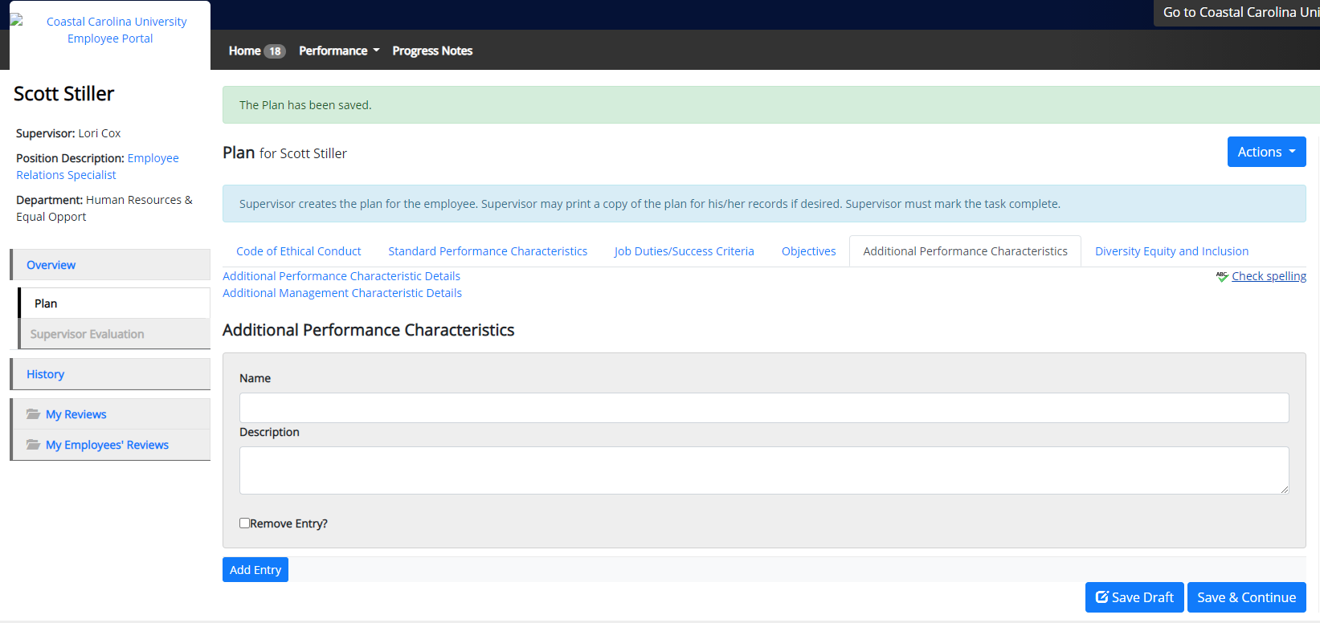
Completing the EPMS Planning Stage
To include “Additional Performance Characteristics” - select one of the two “Additional Characteristic Details” links for further examples of performance and management characteristics.
Enter the information (“Name” and “Description”) and select “Add Entry” - select “Complete” and then “OK.”
This is optional and NOT required.
Select “Save & Continue.”

Slide 11
Completing the EPMS Planning Stage
NEW Standard Performance Characteristic:
  The following is now reflected on ALL employee planning stage documents
  Commitment to Diversity, Equity, and Inclusion: Recognizes, respects, and appreciates differences in background, lifestyles, viewpoints, and the needs in support of a diverse and inclusive environment.
    Helpful Link - A Framework to Measure Commitment to Diversity and Inclusion: 6 Signature Traits - https://pa-hrsuite-production.s3.amazonaws.com/3083/docs/781.doc

Slide 12
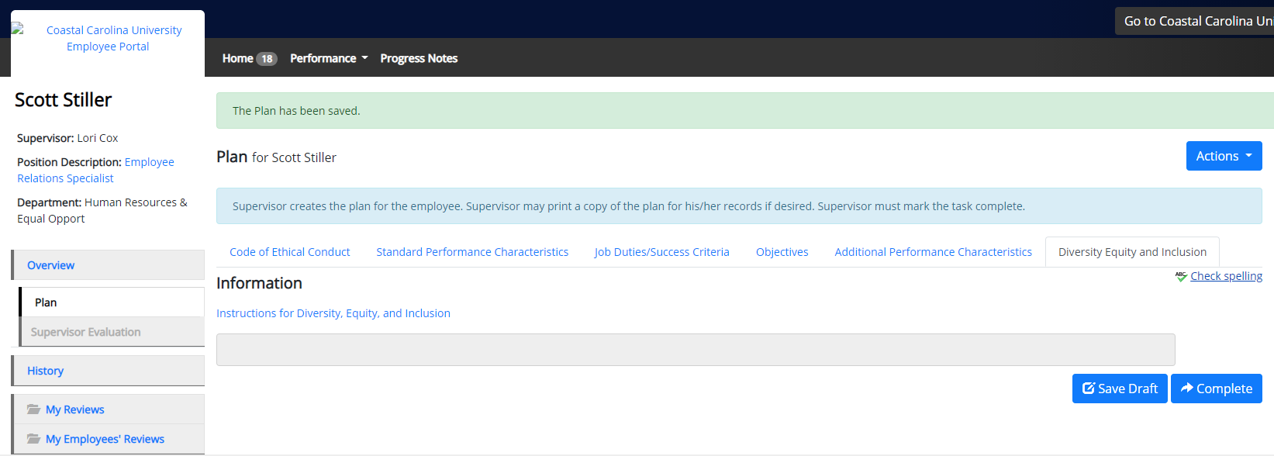
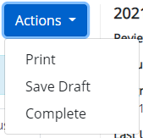
Completing the EPMS Planning Stage
Select “Save Draft” in order to return to the document for further editing.
If no further editing is necessary, select “Complete” to send the document electronically to the employee for acknowledgement.

Slide 13
Employee Acknowledgement and Mid-Year Check-In
Your employee will need to acknowledge the planning stage in PeopleAdmin before you can proceed with completing the “Mid-Year Check-In.”
Please inform your employee to log into PeopleAdmin and acknowledge their plan.
Once acknowledged by the employee, the plan will then appear in your queue under “Mid-Year Check-In.”
In order to view the task, you may need to log out and then log back in to PeopleAdmin.

Slide 14
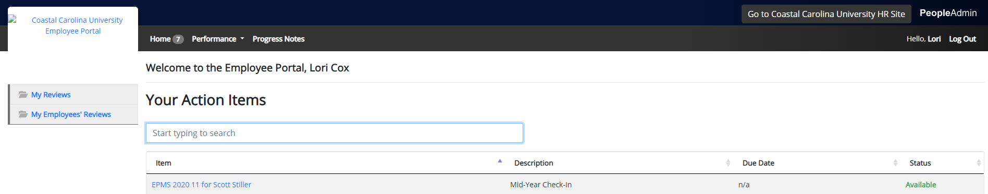
Completing the Mid-Year Check-In
The “Employee Portal” will display “Your Action Items.”
The “Mid-Year Check-In” is an informal opportunity to discuss the employee’s performance.
Select an item reflected in blue to complete the “Mid-Year Check-In.”

Slide 15
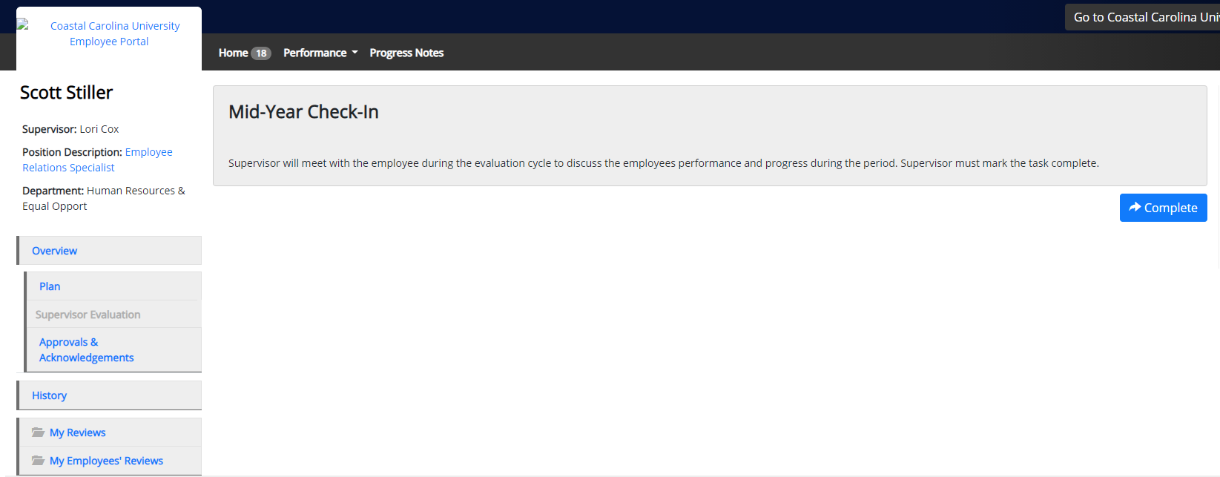
Completing the Mid-Year Check-In
In order to finish the “Mid-Year Check-In,” select “Complete.”

Slide 16
Creating and Completing the EPMS Evaluation
Completing the EPMS Evaluation
Reminder: A rating of “Unsuccessful” cannot be assigned to any “Job Duty” or “Objective” without first contacting HREO and following the “Notice of Substandard Performance Process.”

Slide 17
Completing the EPMS Evaluation
NEW Section
There is now a section that reflects the “Employee’s Datatel ID,” “Employee’s State PIN #” and “Review Type.”
This information should be entered by the supervisor, as it does not auto-populate from Datatel.
To find this data, please refer to the following slides.

Slide 18
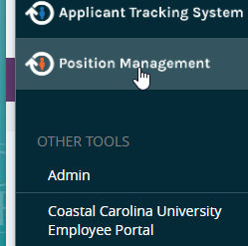
Completing the EPMS Evaluation
The "Employee’s State PIN #” can be located on the employee’s position description.
Select “Position Management” to view the employee’s position description.
The page will display with the header below.
Select “Position Descriptions.”

Slide 19
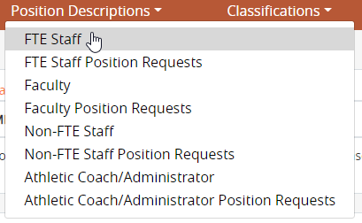
Completing the EPMS Evaluation
Select “FTE Staff” from the drop-down that appears.
A list of your direct reports, along with their “State PN Number,” will appear.

Slide 20
Completing the EPMS Evaluation
Select the “Internal Title” of the employee to locate both the employee’s “State PN Number” and “Employee ID” on their position description.
This data will be entered into the evaluation after completing the “Standard Performance Characteristics” section.

Slide 21
Completing the EPMS Evaluation
To begin completing the evaluation process, make sure your “User Group” – located near the top right - reflects “Supervisor.” If it does not, choose it from the drop down menu.
Select the three blue dots located near the top left (to the left of “Applicant Tracking System”) to reveal the “Coastal Carolina University Employee Portal.”
Select “Coastal Carolina University Employee Portal.”

Slide 22
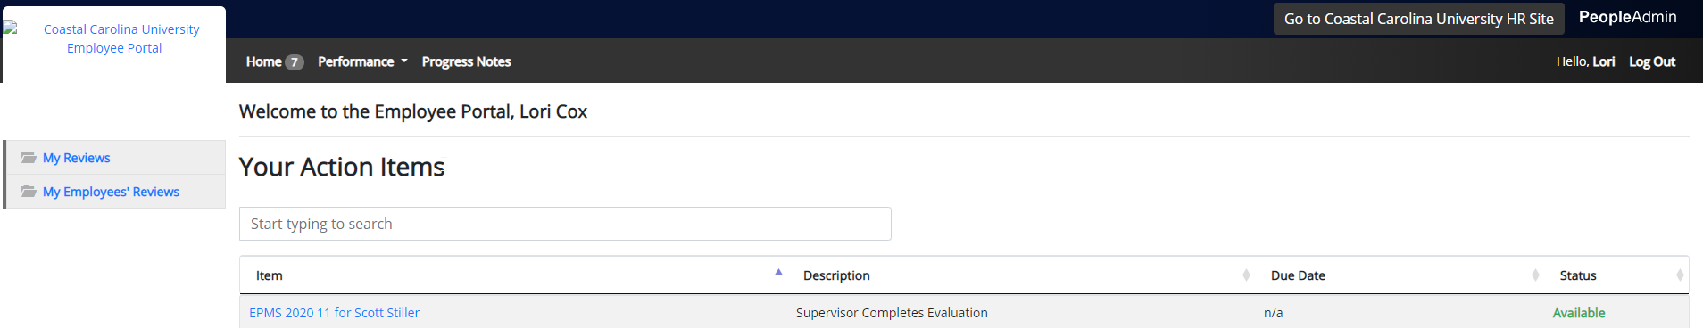
Completing the EPMS Evaluation
The “Employee Portal” will display “Your Action Items.”
Select an “Item” reflected in blue to begin the process of completing the evaluation.

Slide 23
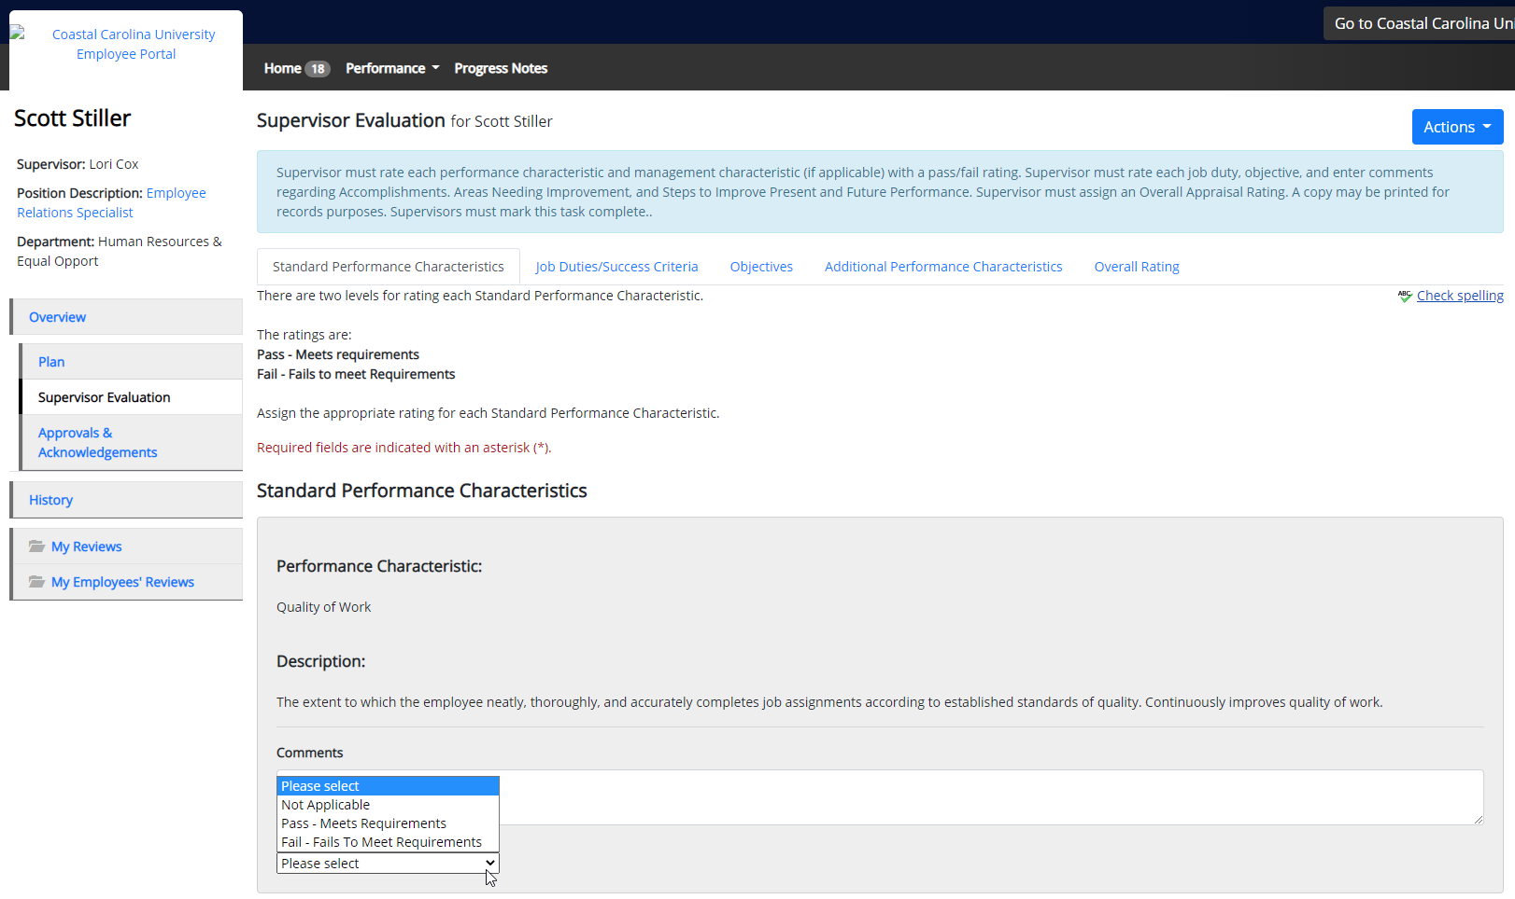
Completing the EPMS Evaluation
Use the drop-down to select a rating for each “Standard Performance Characteristic.”
Note: “Management Performance Characteristics” are for management (supervisory) positions ONLY.
“Comments” are optional, but encouraged. As they become part of the permanent record, “Comments” must be professional, appropriate, and job related.

Slide 24
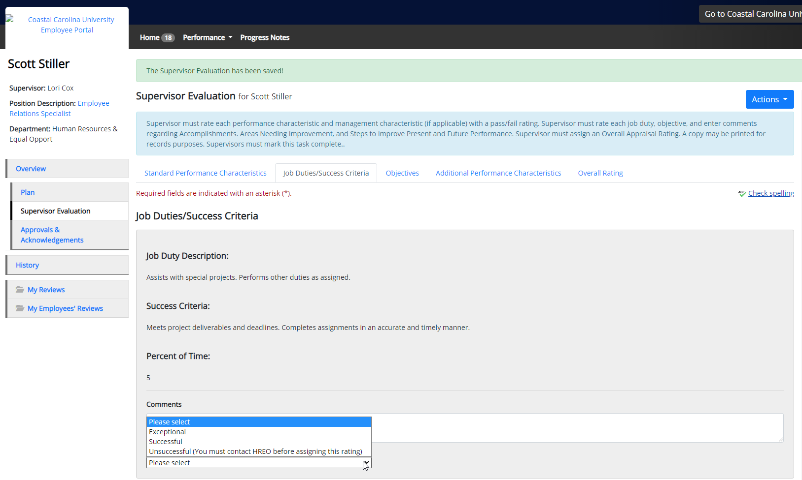

Completing the EPMS Evaluation
Select a rating for each “Job Duty/Success Criteria” – use the drop-down.
Each “Job Duty/Success Criteria” must receive a rating.
“Comments” are optional, but strongly encouraged. As they become part of the permanent record, “Comments” must be professional, appropriate, and job related.
Select “Save & Continue.”

Slide 25
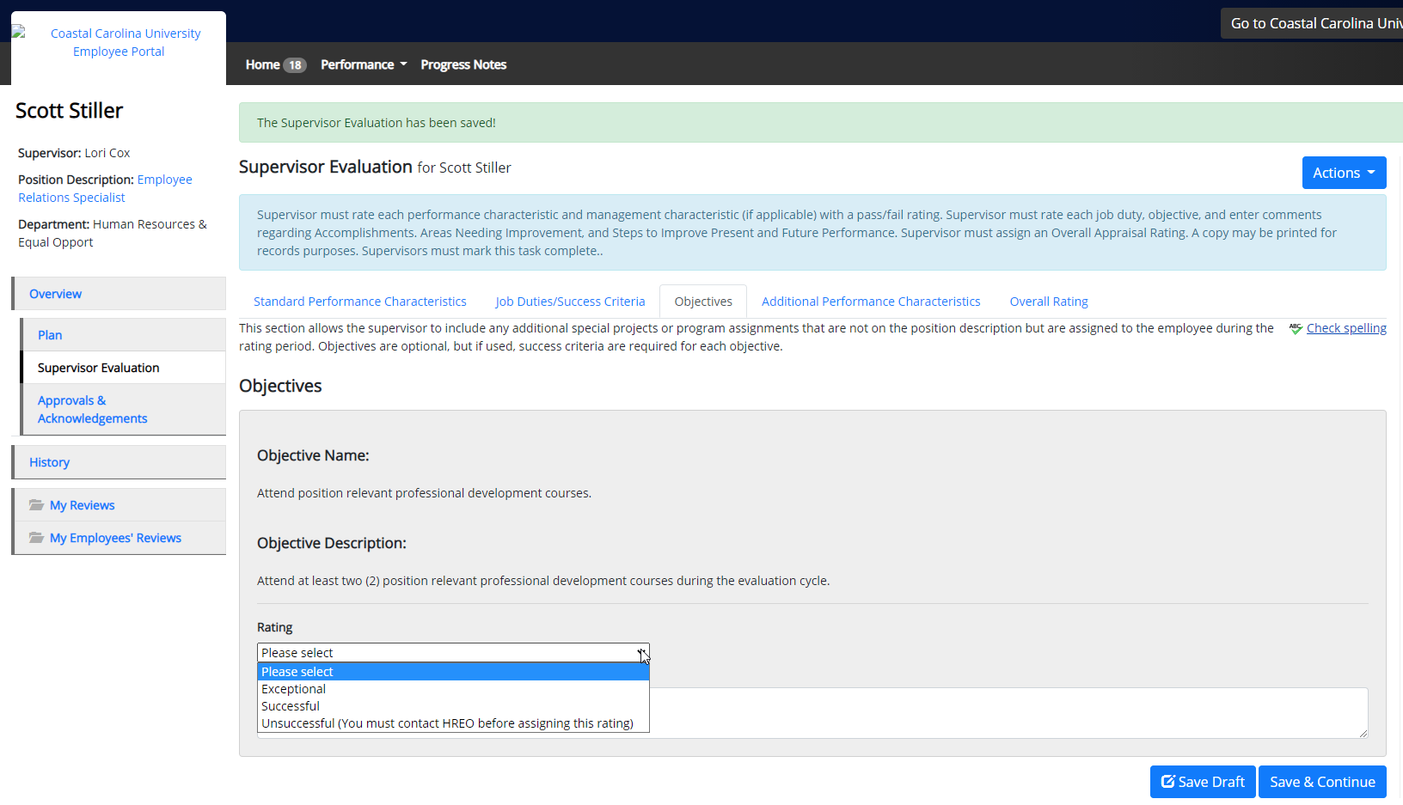
Completing the EPMS Evaluation
Select a rating (other that “Unsuccessful”) from the drop-down for each “Objective” – this is required.
“Comments” are optional, but encouraged. As they become part of the permanent record, “Comments” must be professional, appropriate, and job related.
“Objectives” are weighted in the employee’s “Overall Rating.”
Select “Save & Continue.”

Slide 26
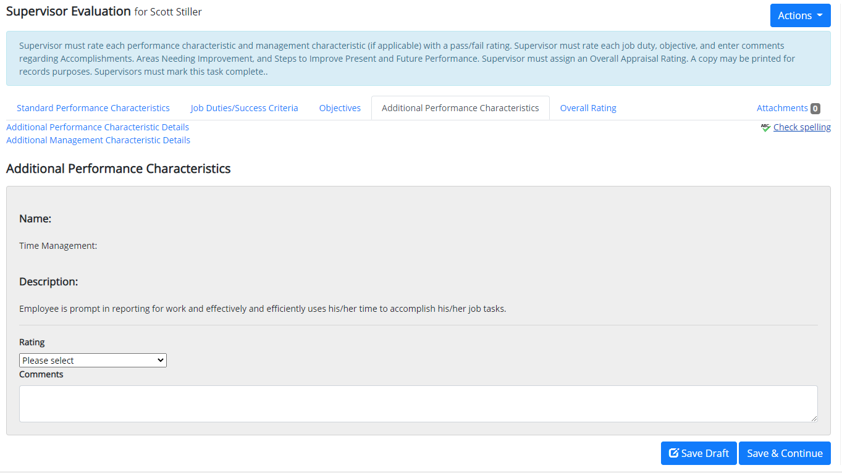
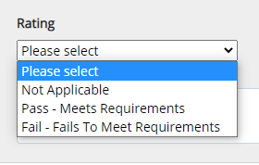
Completing the EPMS Evaluation
Select a rating for each “Additional Performance Characteristic” – use the drop-down.
“Comments” are optional, but encouraged. As they become part of the permanent record, “Comments” must be professional, appropriate, and job related.
Select “Save & Continue.”

Slide 27
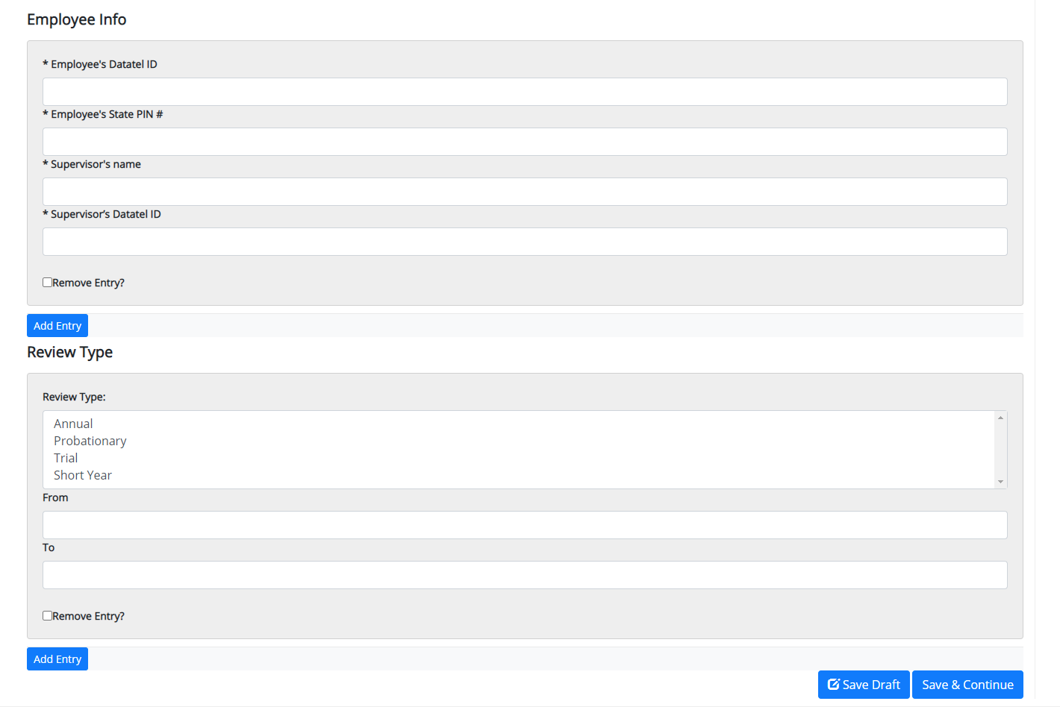
Completing the EPMS Evaluation
“Employee Info” (gathered from position description) and “Review Type” may be entered here.
Enter employee and supervisor information – select “Add Entry.”
Select “Review Type” and dates of evaluation (e.g., Annual – 11/01/2020 – 10/31/2021) – select “Add Entry.”
Do not select “Remove Entry.”
Select “Save & Continue.”

Slide 28
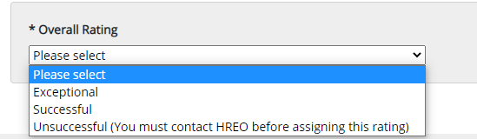
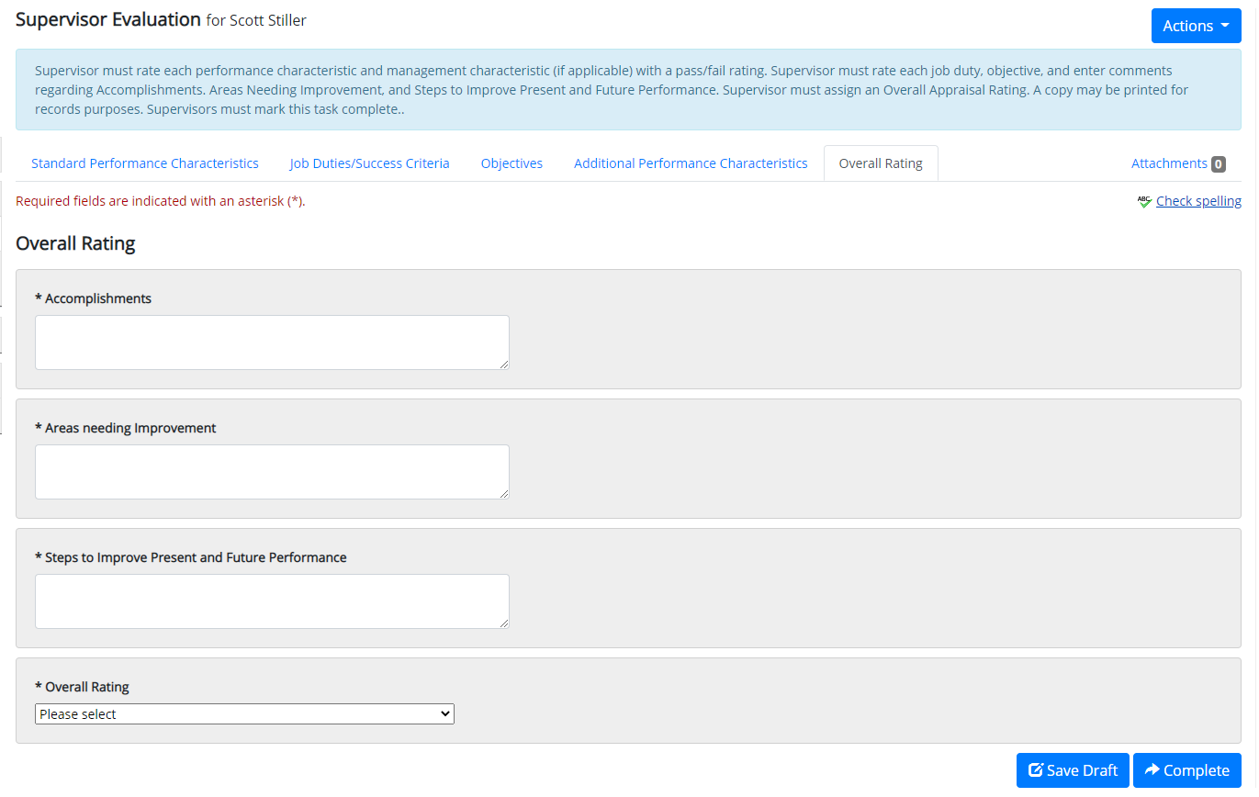
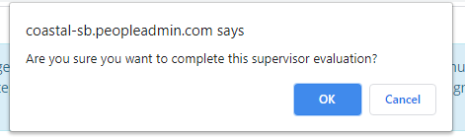
Completing the EPMS Evaluation
“Comments” are required in each field and, as they become part of the permanent record, must be professional, appropriate, and job related.
Select “Overall Rating.”
Select “Complete” and then “OK.”

Slide 29
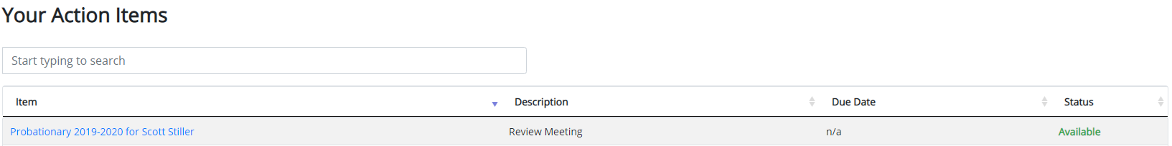
Completing the EPMS Evaluation
Once you (Rater) complete the evaluation, it will be sent electronically to your supervisor (Reviewer) to review and approve.
After your supervisor approves the evaluation, it will appear in your queue under “Your Action Items.”
Log into PeopleAdmin and select the employee’s evaluation under “Item.”

Slide 30
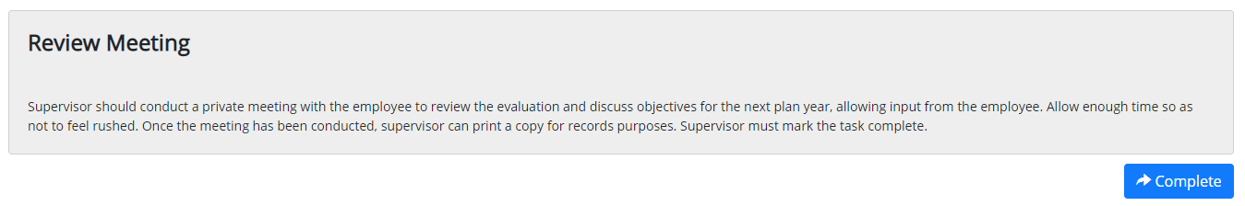
Completing the EPMS Evaluation
Conduct the “Review Meeting” with the employee; then select “Complete.”
  Note: Please allow sufficient time and ensure privacy for this meeting.
The evaluation will be sent electronically to the employee for review and acknowledgement.
Please notify your employee to log into PeopleAdmin and acknowledge their evaluation.
  Note: If the employee refuses to electronically acknowledge the evaluation, then the employee should select “Dispute” online and send an email to hr@coastal.edu stating their refusal to sign the document.
Once the employee acknowledges the evaluation, it will be sent to HREO to complete the process.

Slide 31
Closing Remarks
For detailed information regarding the process, please refer to FAST-221 https://www.coastal.edu/policies/pdf/fast-221-february2020.pdf.
HREO contact information:
  Scott D. Stiller – sstiller@coastal.edu or 843.349.2537
  Lori Cox – lcox1@coastal.edu or 843.349.6496

